Slide 1
Object Oriented Data Structures
Recursion
Introduction to Recursion
Principles of Recursion
Backtracking: Postponing the Work
Tree-Structured Programs: Look Ahead in Games

Slide 2







Recursion
Recursion
Recursion
Recursion
Recursion
Recursion
Recursion
Recursion

Slide 3
Stack Frames
D
D
B
C
C
C
D
D
D
A
A
A
A
A
A
A
D
D
D
D
D
M
M
M
M
M
M
M
M
M
M
M
M
M
M
M
Time

Slide 4
Tree of Subprogram Calls
Start
Finish
M
A
D
B
C
D
D

Slide 5
Recursive Definitions
1 if n = 0
n*(n-1)! if n > 0
n! =
1 if n = 0 and x not 0
x*(x^{n-1}) if n > 0 and x not 0
x^{n} =

Slide 6
Designing Recursive Algorithms
Find the key step
Find a stopping rule (base case)
Outline your algorithm
Check termination
Draw a recursion tree

Slide 7
Tail Recursion
The very last action of a function is a recursive call to itself
Using a stack not necessary
Reassign the calling parameters to the values specified in the recursive call and then repeat the function

Slide 8
Backtracking
An algorithm which attempts to complete a search for a solution to a problem by constructing partial solutions, always ensuring that the partial solutions remain consistent with the requirements. The algorithm then attempts to extend a partial solution toward completion, but when an inconsistency with the requirements of the problem occurs, the algorithm backs up (backtracks) by removing the most recently constructed part of the solution and trying another possibility.

Slide 9
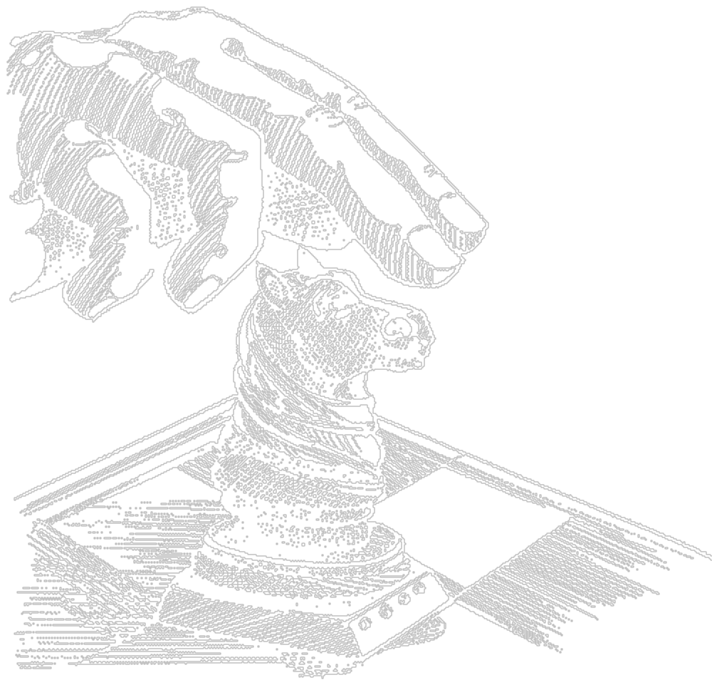
Knight's Tour
Legal Knight Moves

Slide 10
Knight's Tour
Legal Knight Moves

Slide 11
Knight's Tour
Legal Knight Moves

Slide 12
Knight's Tour
1
10
31
64
33
26
53
62
63
34
12
7
28
25
30
51
9
2
11
32
27
52
61
54
8
24
35
50
41
6
13
29
3
18
5
36
49
40
55
60
14
23
21
16
46
57
39
42
17
4
19
48
37
44
59
56
20
15
22
45
58
38
47
43
Legal Knight Moves

Slide 13
Application: Depth- And Breadth-First Search
F
S

Slide 14
Cell Description
0
1
2
3
4
5
6
7
0000
0001
0010
0011
0100
0101
0110
0111
8
9
10
11
12
13
14
15
1000
1001
1010
1011
1100
1101
1110
1111

Slide 15
Application: Depth- And Breadth-First Search
14
12
5
4
6
10
9
4
3
10
9
5
2
13
2
14
14
10
12
2
9
1
1
3
11

Slide 16
Class Cell Maintain:
A number. This is an integer value used to identify the cell. Cells are numbered consecutively from left to right and top to bottom.
A list of neighboring cells. Each cell will have an entry in this list for all other neighbor cell that can be reached.
A Boolean value, named visited, that will be used to mark a cell once it has been visited. Traversing a maze often results in dead ends, and the need to back up and start again. Marking cells avoids repeating effort and potentially walking around in circles.

Slide 17
Class Description
class cell{
public:
cell(int n) : number(n), visited(false) {}
void addNeighbor(cell * n)
{neighbors.push_back(n);}
void visit (deque<cell *> &);
protected:
int number;
bool visited;
list <cell *> neighbors;
};

Slide 18
Class Maze
class maze{
public:
maze(istream &);
void solveMaze();
protected:
cell * start;
bool finished;
deque <cell *> path; // used to hold the path
// or paths currently
// being traversed
};

Slide 19
maze::maze(istream & infile)
// initialize maze by reading from file
{
int numRows, numColumns;
int counter = 1;
cell * current = 0;
infile >> numRows >> numColumns;
vector <cell *> previousRow (numRows, 0);

Slide 20
for(int i = 0; i < numRows; i++)
for(int j=0; j<numColumns; j++){
current = new cell(counter++);
int walls;
infile >> walls;
if((i>0) && ((walls & 0x04)==0)) {
current->addNeighbor(previousRow[j])
previousRow[j]->addNeighbor(current);
}
if((j>0> && ((walls & 0x08) == 0)){
current->addNeighbor(previousRow[j-1]);
previousRow[j-1]->addNeighbor(current);
}
previousRow[j] = current;
}
start = current;
finished = false;

Slide 21
14
12
5
4
6
1
10
9
4
3
10
2
3
9
5
2
13
2
3
2
4
14
14
10
12
2
4
3
5
9
1
1
3
11
5
4
previousRow[j]
previousRow[0]
1
previousRow[1]
2
previousRow[2]
3
previousRow[3]
4
previousRow[4]
5

Slide 22
14
12
5
4
6
1
6
10
9
4
3
10
2
3
9
5
2
13
2
3
2
4
14
14
10
12
2
4
3
5
9
1
1
3
11
5
4
previousRow[j]
6
1
previousRow[0]
6
previousRow[1]
2
previousRow[2]
3
previousRow[3]
4
previousRow[4]
5

Slide 23
14
12
5
4
6
1
6
10
9
4
3
10
2
3
7
9
5
2
13
2
3
2
4
14
14
10
12
2
4
3
5
9
1
1
3
11
5
4
previousRow[j]
6
1
previousRow[0]
6
previousRow[1]
7
7
2
previousRow[2]
3
previousRow[3]
4
previousRow[4]
5

Slide 24
void maze::solveMaze()
// solve the maze puzzle
{
start->visit(path);
while ((!finished) && (! path.empty ())){
cell * current = path.front();
path.pop_front();
finished = current->visit(path);
}
if ( ! finished)
cout << “no solution found\n”;
}

Slide 25
bool cell::visit(deque<cell *> & path)
{ //depth first
if(visited) // already been here
return false;
visited = true; // mark as visited
cout << “visiting cell “ << number << endl;
if (number == 1) {
cout << “puzzle solved\n”;
return true;
}
list <cell *>:: iterator start, stop;
start = neighbors.begin();
stop = neighbors.end();
for ( ; start != stop; ++start)
if (! (*start)->visited)
path.push_front(*start);
return false;
}

Slide 26
bool cell::visit(deque<cell *> & path)
{// breadth first
if(visited) // already been here
return false;
visited = true; // mark as visited
cout << “visiting cell “ << number << endl;
if (number == 1) {
cout << “puzzle solved\n”;
return true;
}
list <cell *>:: iterator start, stop;
start = neighbors.begin();
stop = neighbors.end();
for ( ; start != stop; ++start)
if (! (*start)->visited)
path.push_back(*start);
return false;
}

Slide 27
Depth First vs. Breadth First
Because all paths of length one are investigated before examining paths of length two, and all paths of length two before examining paths of length three, a breadth-first search is guaranteed to always discover a path from start to goal containing the fewest steps, whenever such a path exists.

Slide 28
Depth First vs. Breadth First
Because one path is investigated before any alternatives are examined, a depth-first search may, if it is lucky, discover a solution more quickly than the equivalent breadth-first algorithm.

Slide 29
Depth First vs. Breadth First
In particular, suppose for a particular problem that some but not all paths are infinite, and at least one path exists from start to goal that is finite. A breadth-first search is guaranteed to find a shortest solution. A depth-first search may have the unfortunate luck to pursue a never-ending path, and can hence fail to find a solution.

Slide 30

Chapter 5 Ripples Away

